Slide 1
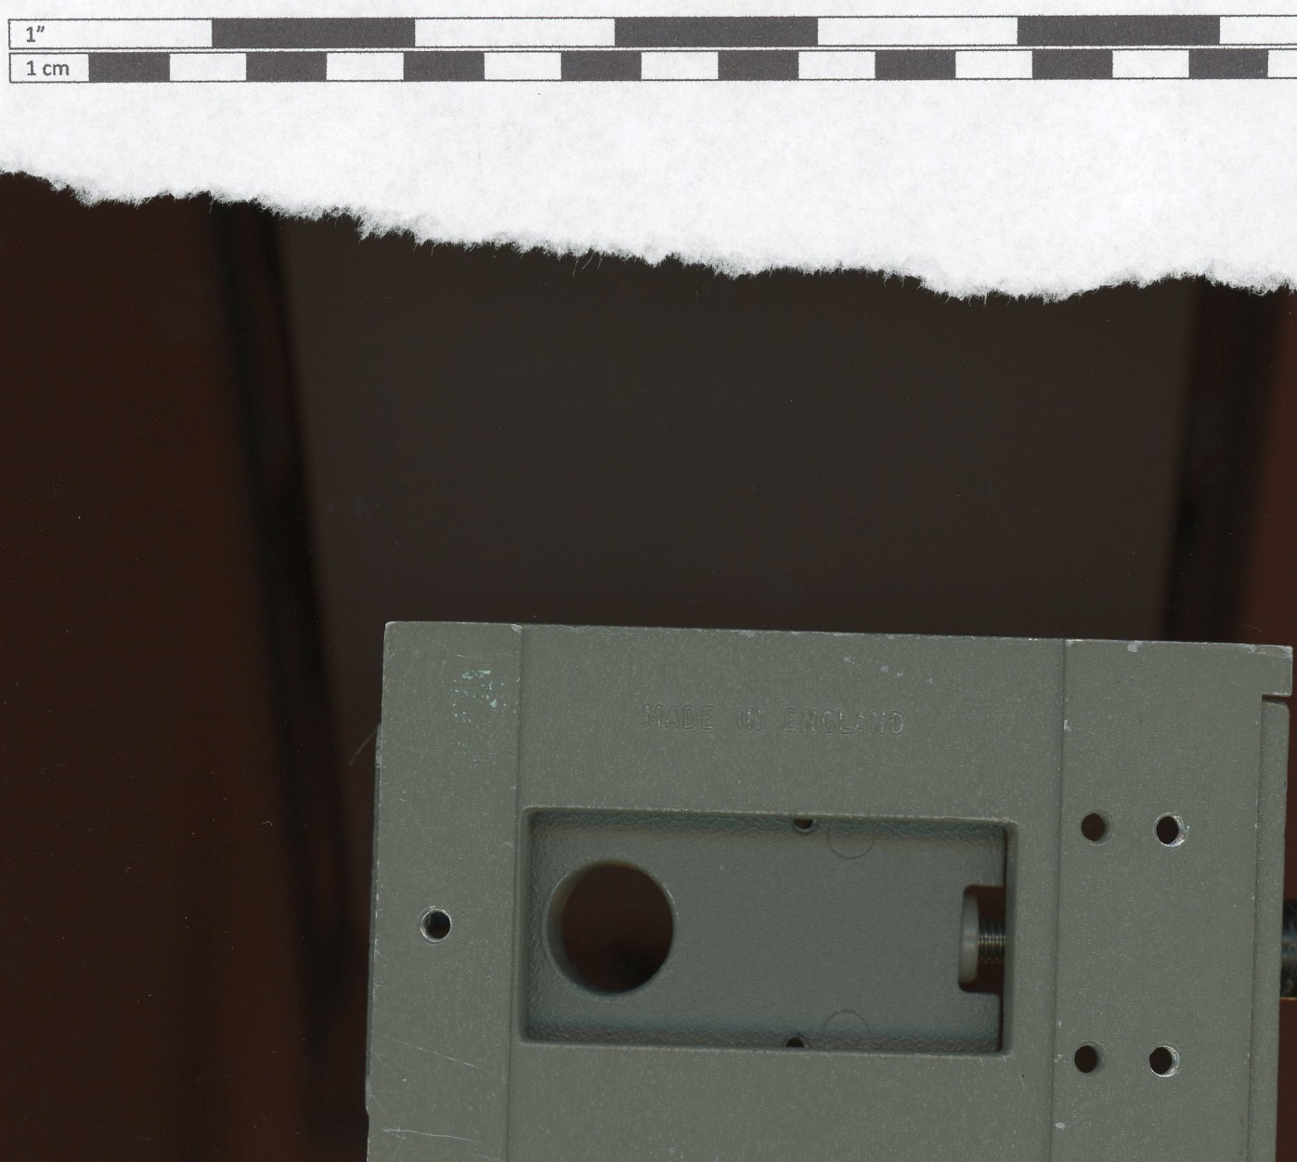
1” in PPT
A, 0.1, 3.56 = 3.5614
B, 0.01, 0.37 = 0.3701
C, 1.14, 0.04 = 1.1407
B
A
C

Slide 2
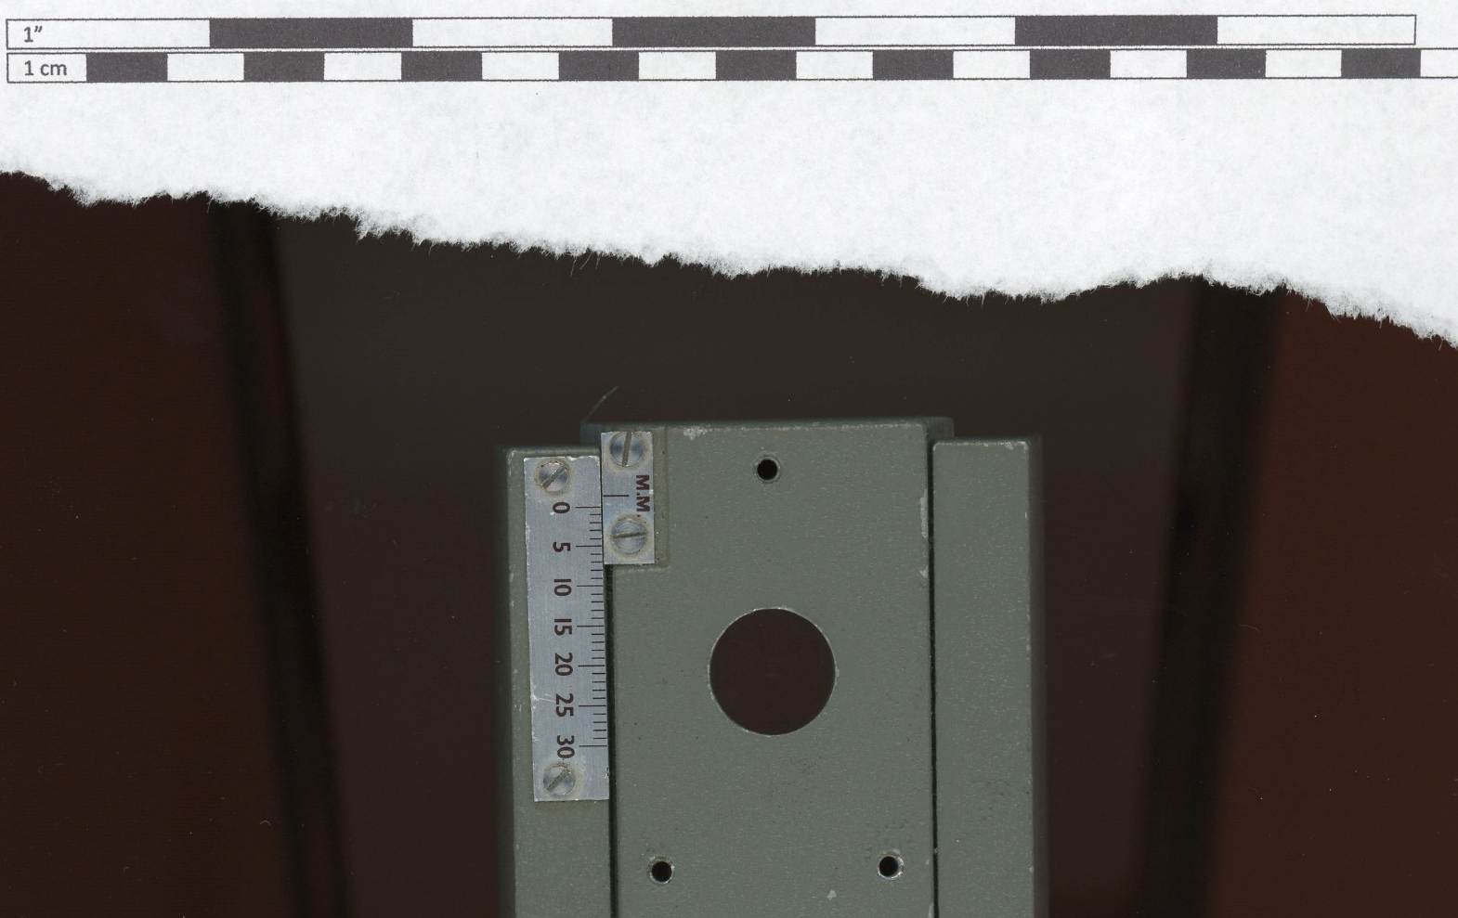
1” in PPT
D, 1.96, 0.04 = 1.9604
E, 0.02, 1.12 = 1.1201
D
E

